Slide 1
CS 170 Any time Algorithm
Notes based from Dr. Eamonn Keogh

Slide 2


Slide 3
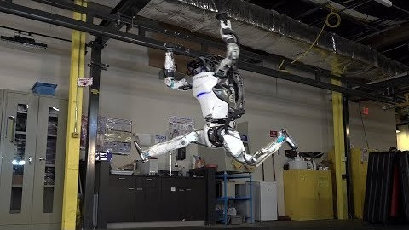

Slide 4
Anytime Algorithms for AI
Today we will learn about anytime algorithms.
Anytime algorithms are a general tool beyond A.I., but are especially critical for AI agents that operate in the real world (driverless cars, robots, web-bots etc)
Let's start with motivation…
https://www.youtube.com/watch?v=lgpZfSHaDAY

Slide 5
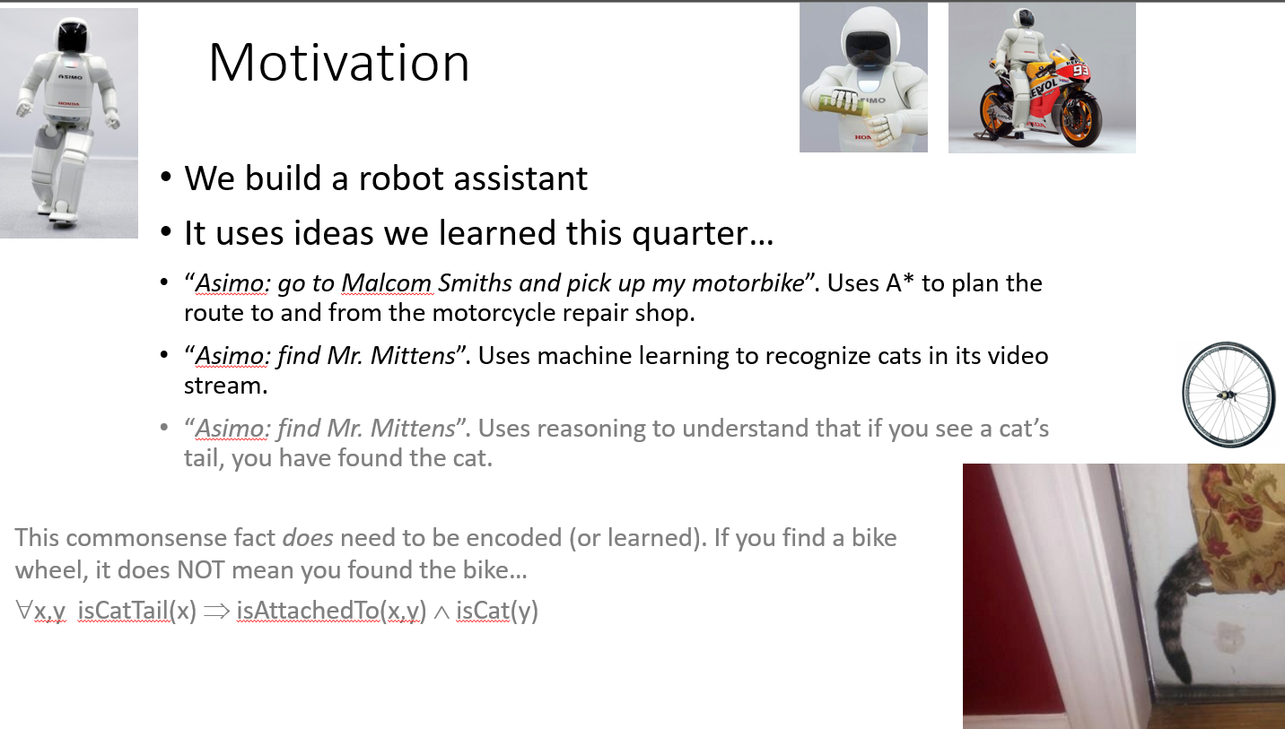

Slide 6
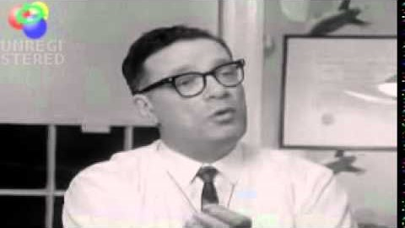

Slide 7
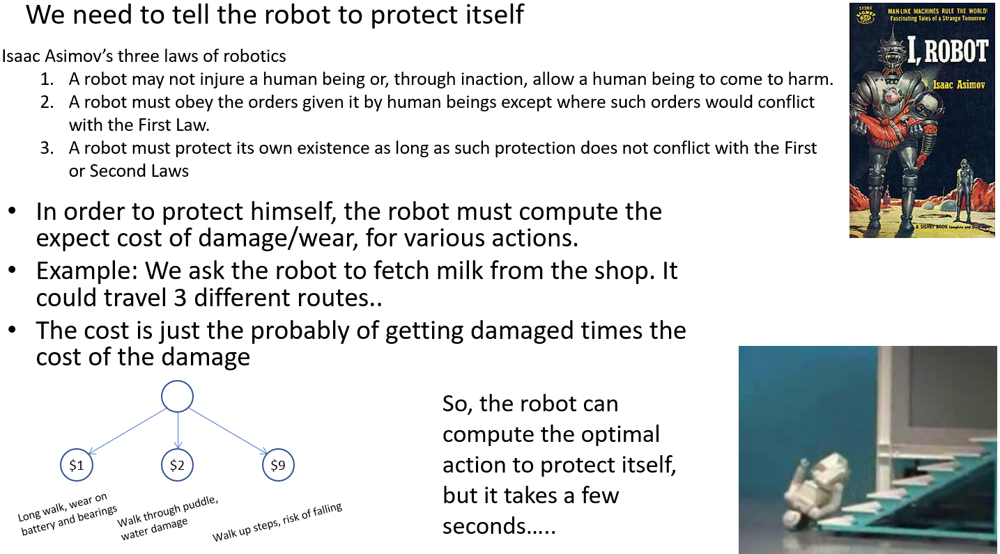

Slide 8
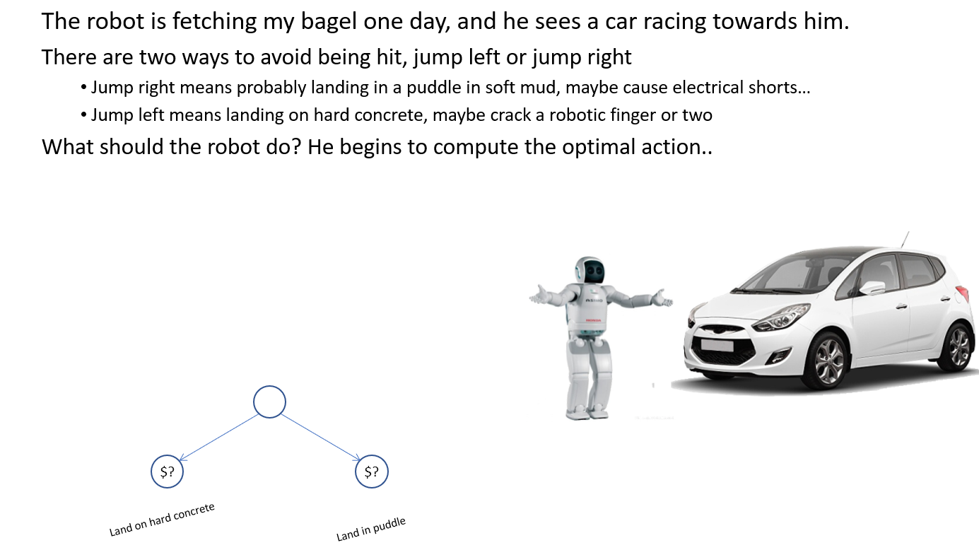

Slide 9
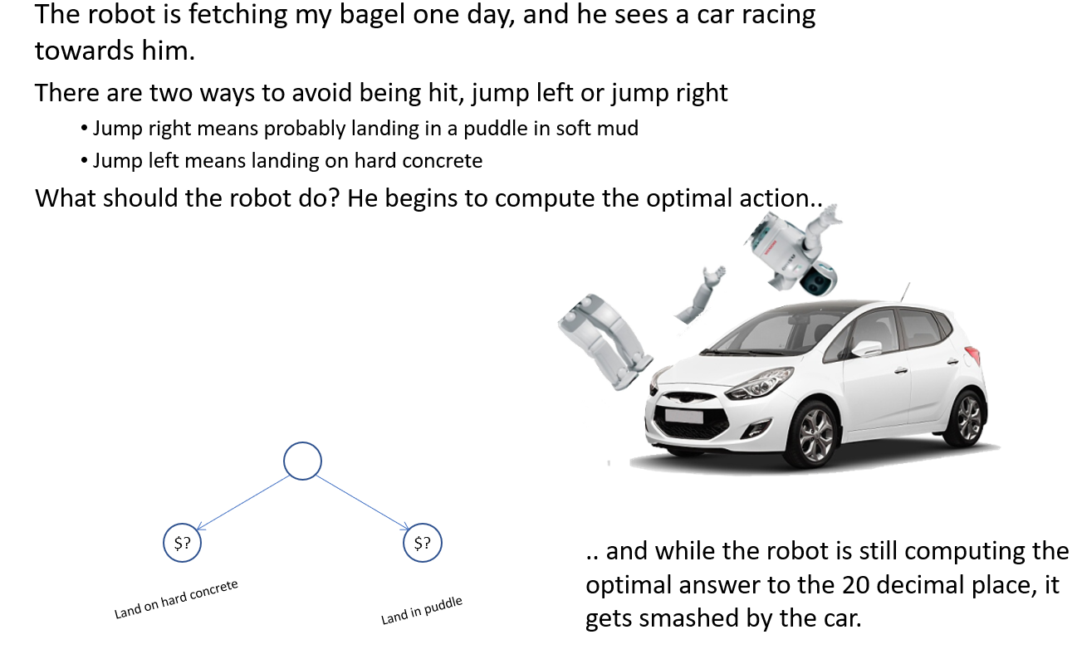

Slide 10
Takeaway
There are problems for which we can compute a solution
But sometimes, while computing a solution, we are forced to make a choice NOW!
In such cases, we would be better off giving some answer, even if it is not optimal.
There is a framework to support this, anytime algorithms.

Slide 11
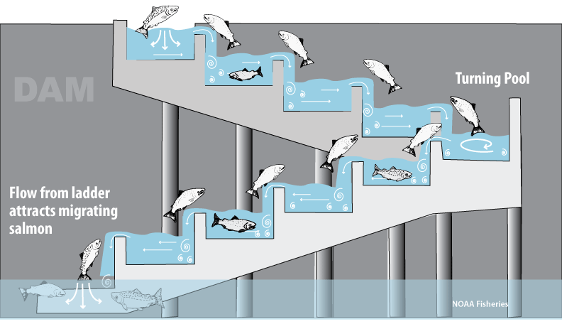
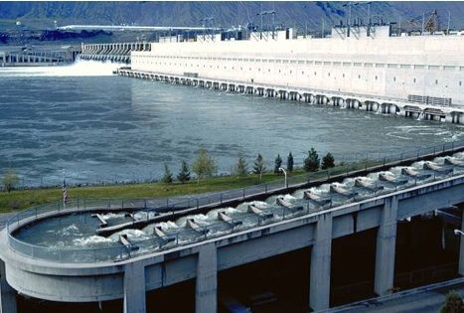
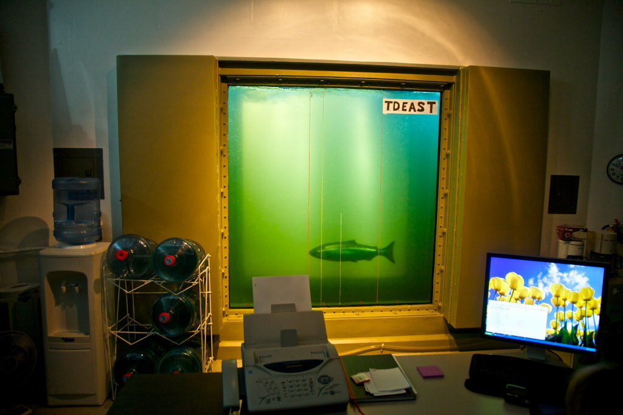
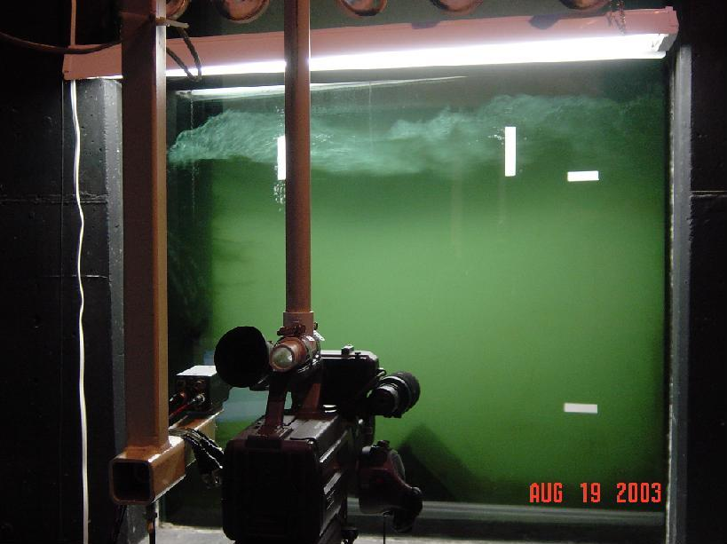

Slide 12
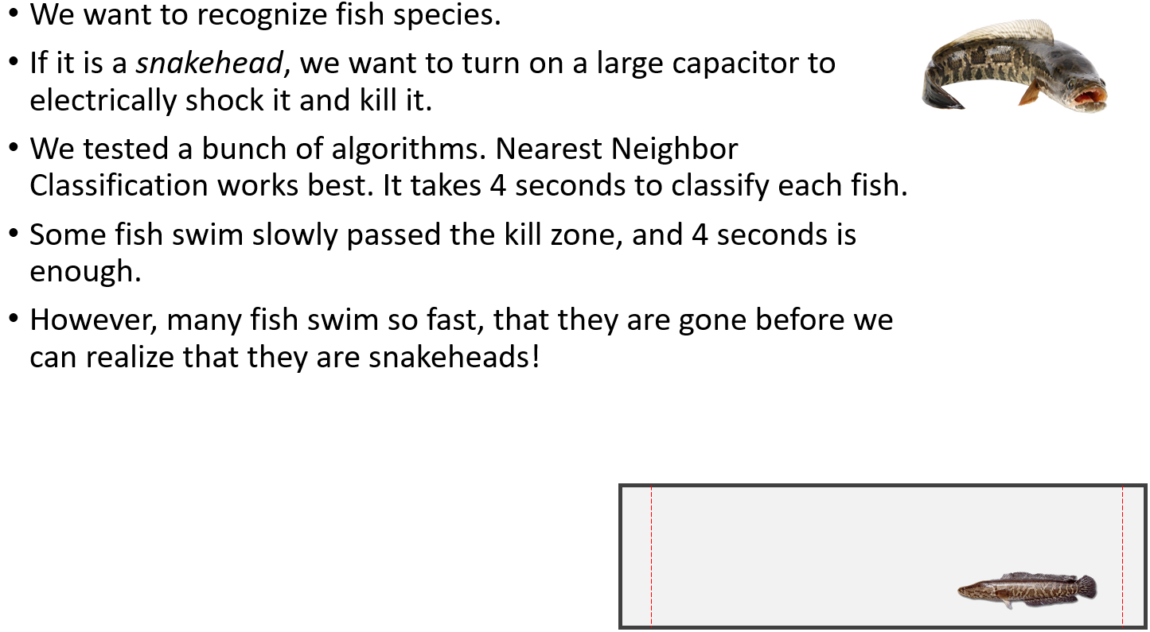

Slide 13
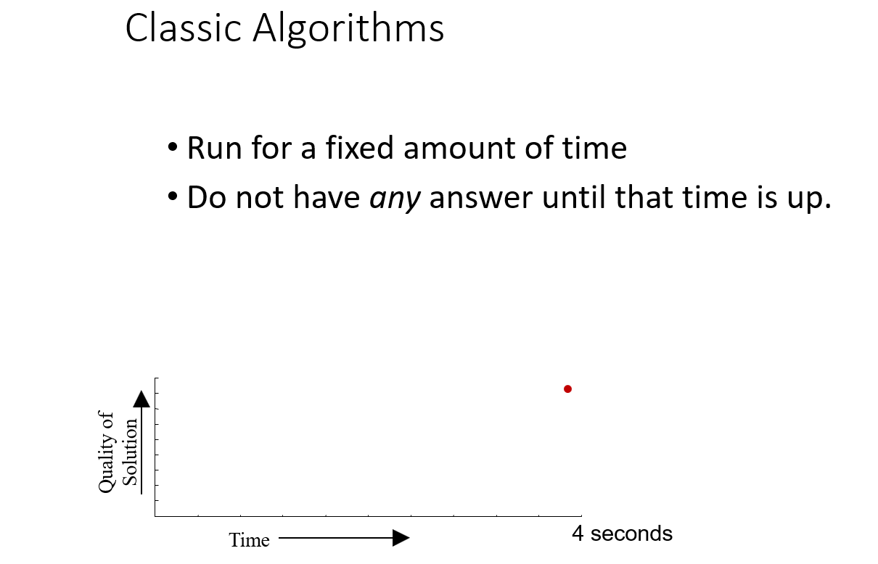

Slide 14
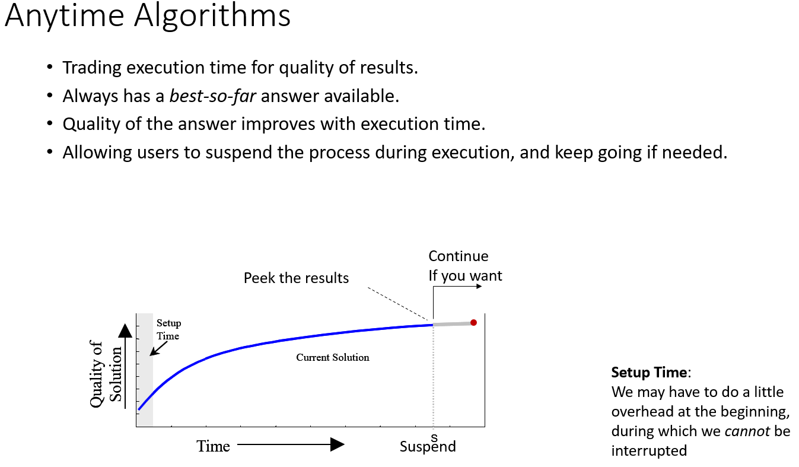

Slide 15
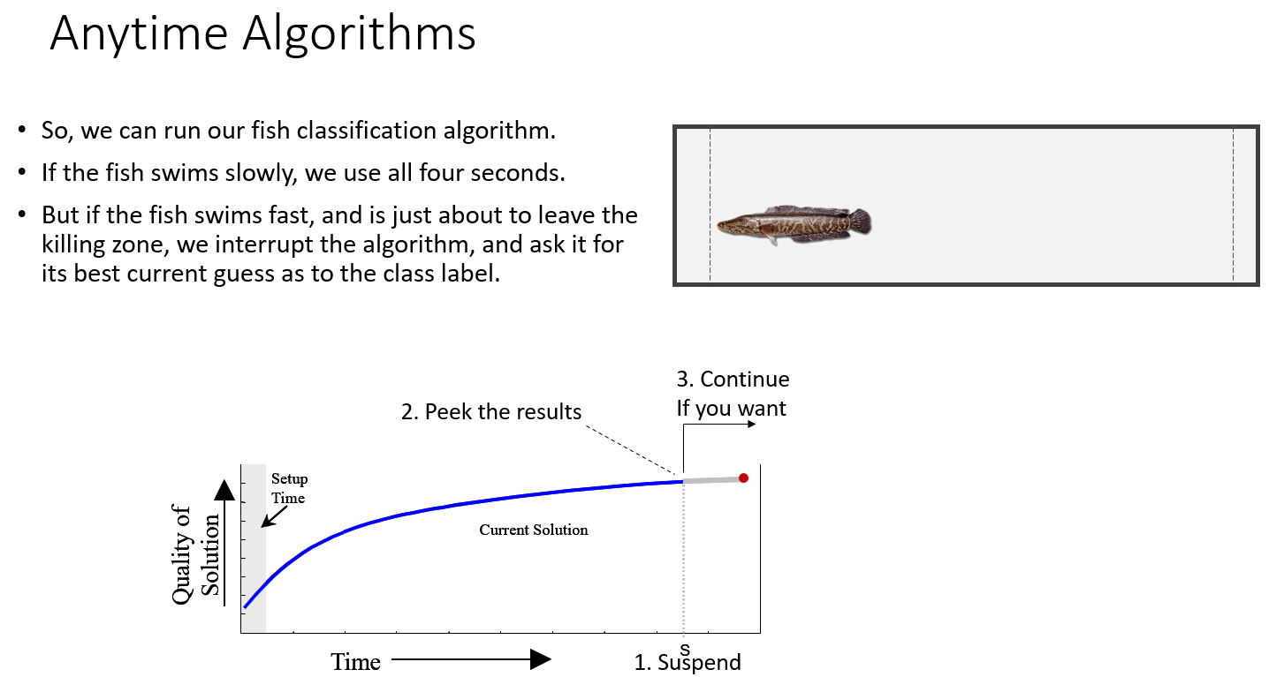

Slide 16
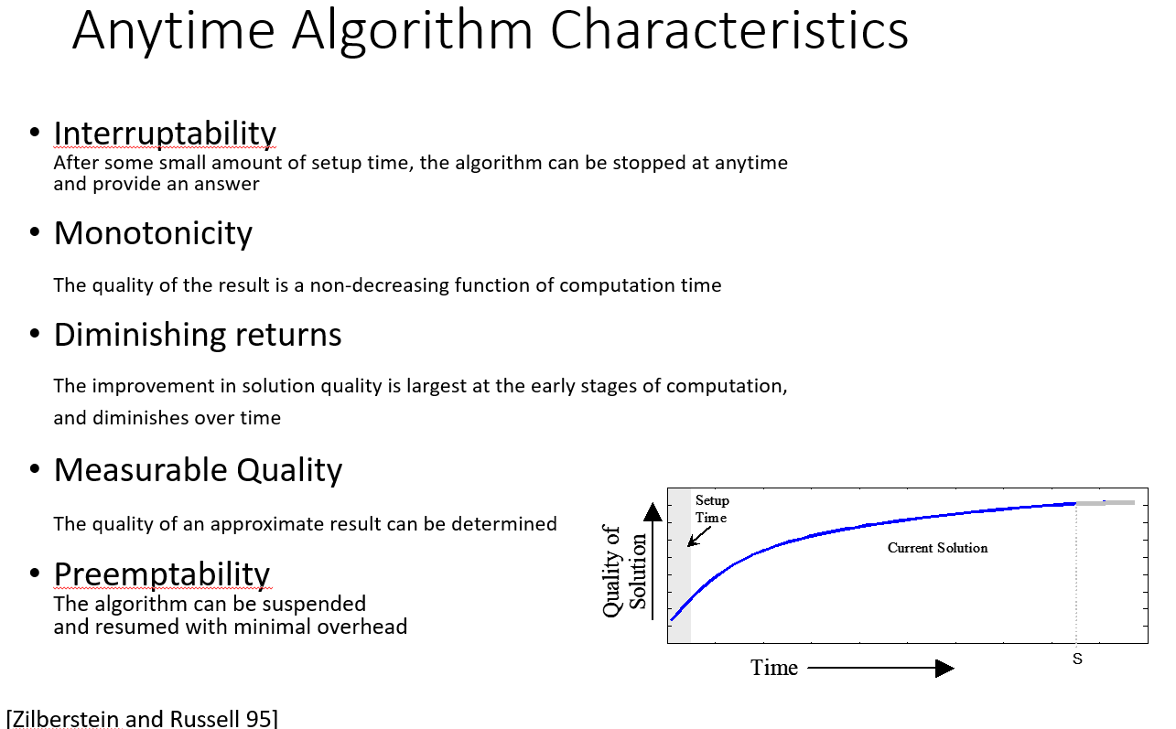

Slide 17
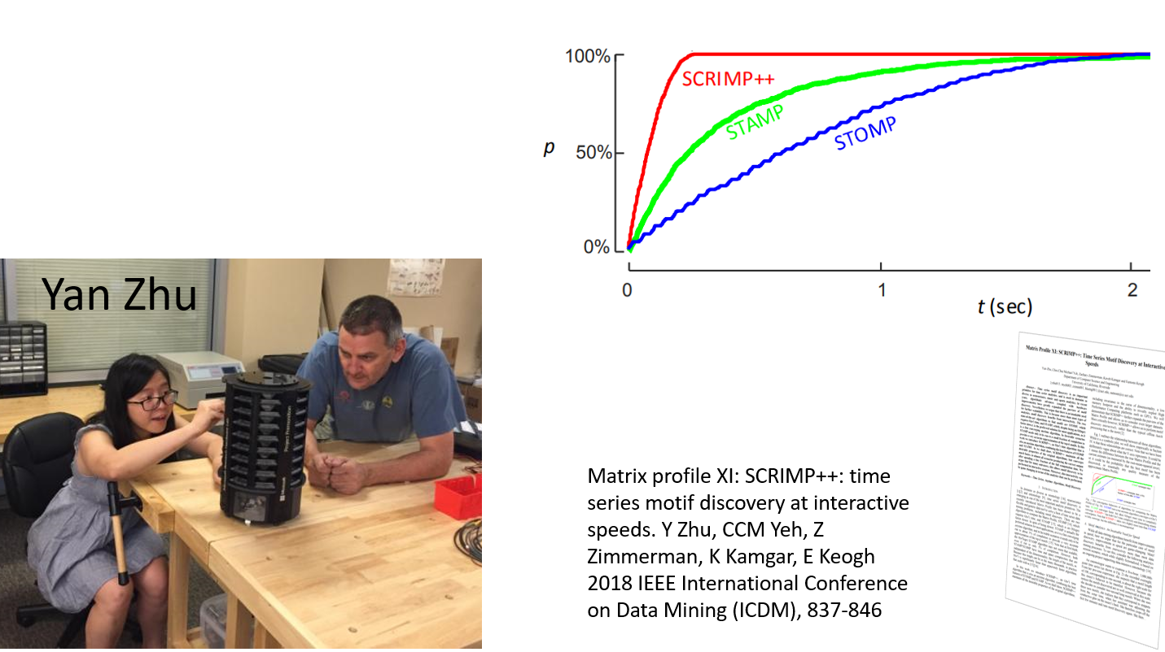

Slide 18
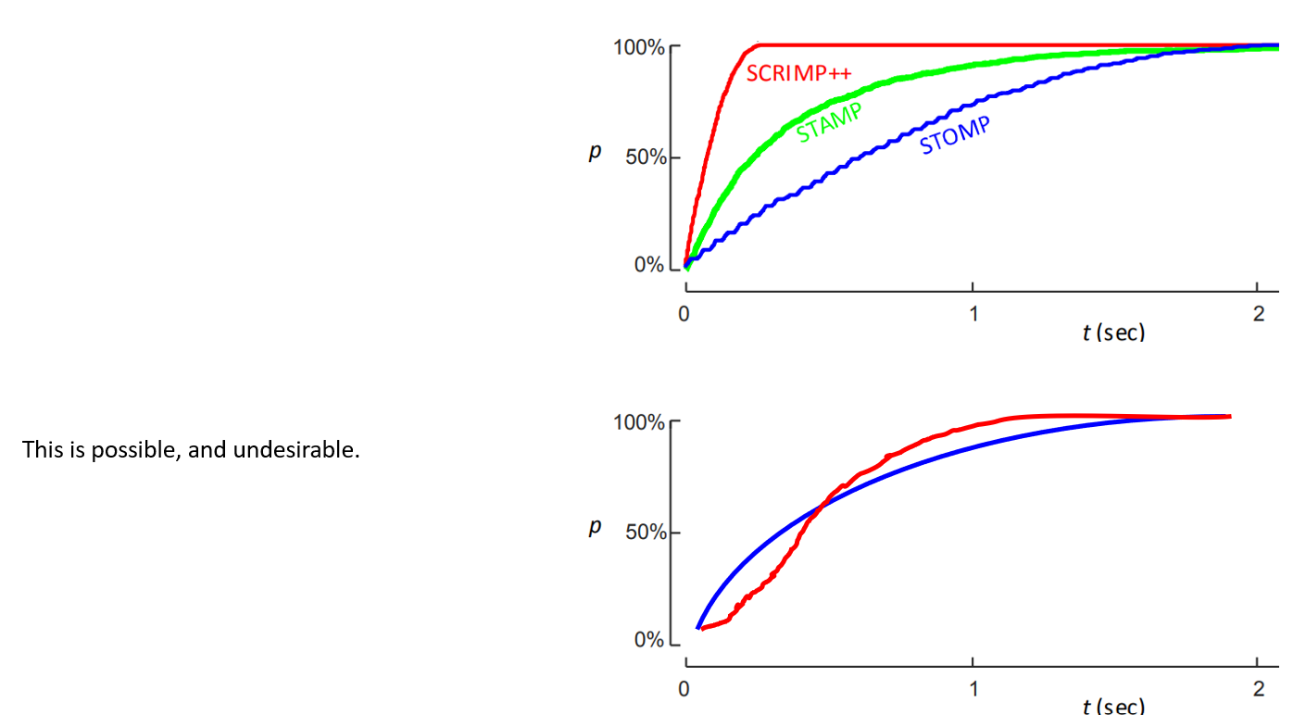

Slide 19
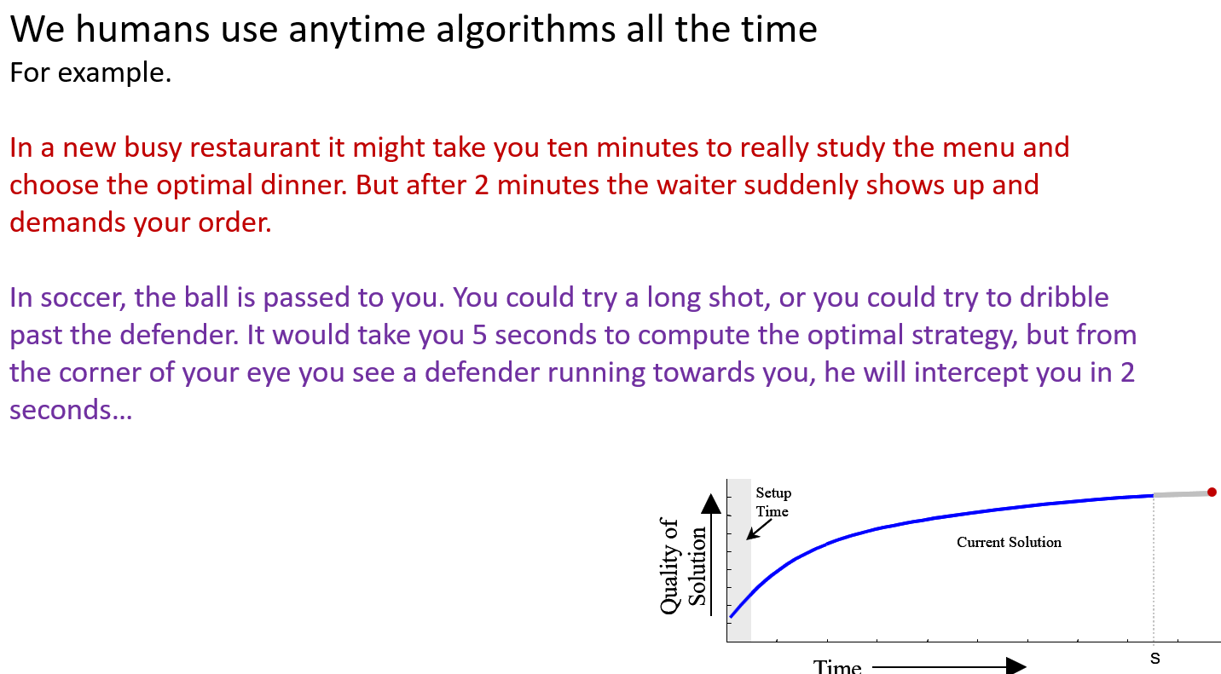

Slide 20
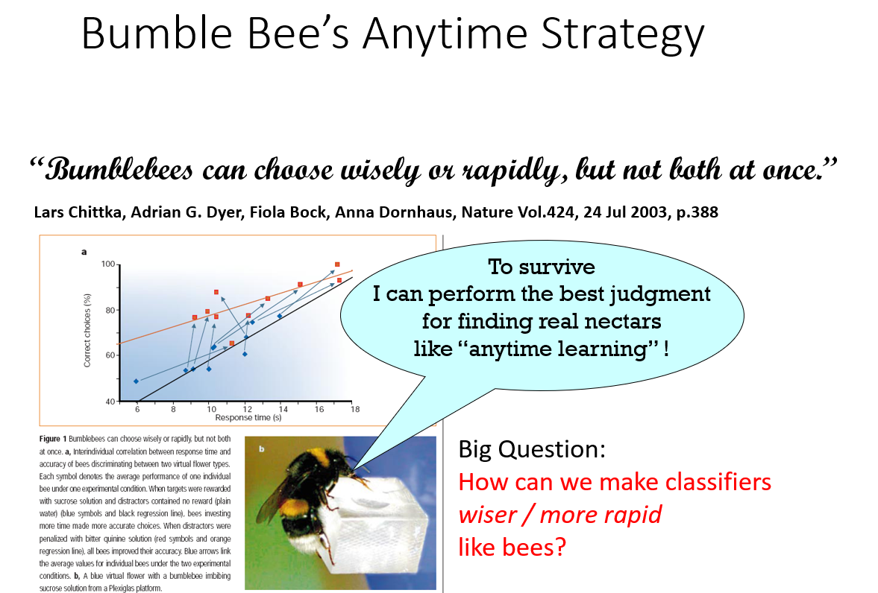

Slide 21
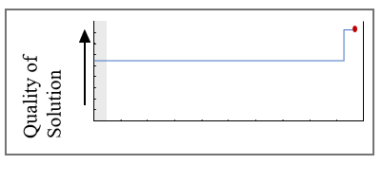
Some algorithms that we know about are already anytime algorithms
Some algorithms can be converted into anytime algorithms with a little work
Some algorithms are just very hard to convert into an anytime framework.
Already anytime algorithms
Greedy search, random search, Simulated-Annealing, Genetic Algorithms, k-means clustering, decision tree construction, Monte Carlo game tree search…
Can be converted to anytime algorithm
A-star. Suppose we do the following, we first run just greedy search, and record the answer we get (which will almost certainly be suboptimal), we then start classic A-star…
Minimax. If we do these it in iterative deepening fashion, it becomes an anytime algorithms (see next slide)
Hard/impossible to convert to anytime algorithm (I think)
Theorem proving. For resolution refutation, until the algorithm stops, it is impossible to know if it is leaning towards TRUE or not. It is an all-or-nothing algorithm.
Dendrogram construction.

Slide 22
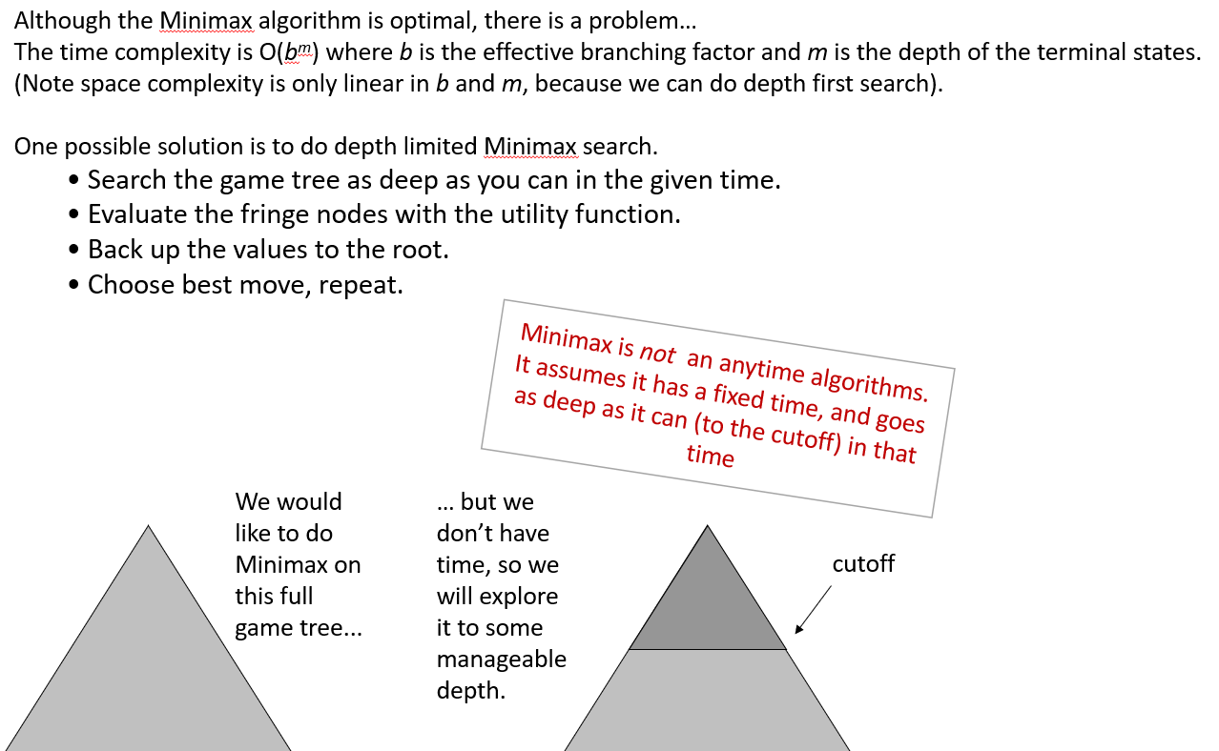

Slide 23
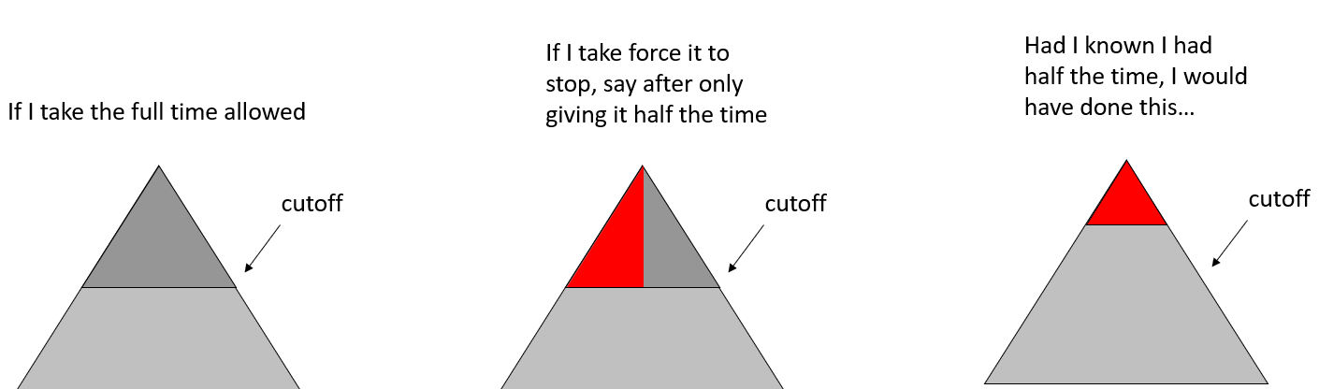

Slide 24
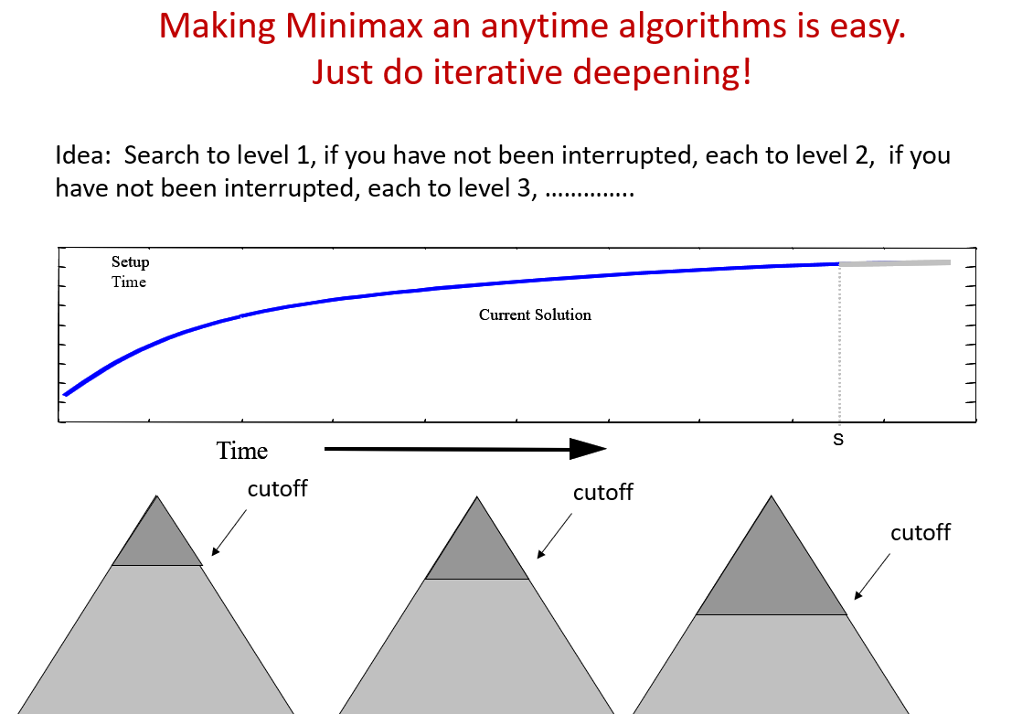

Slide 25
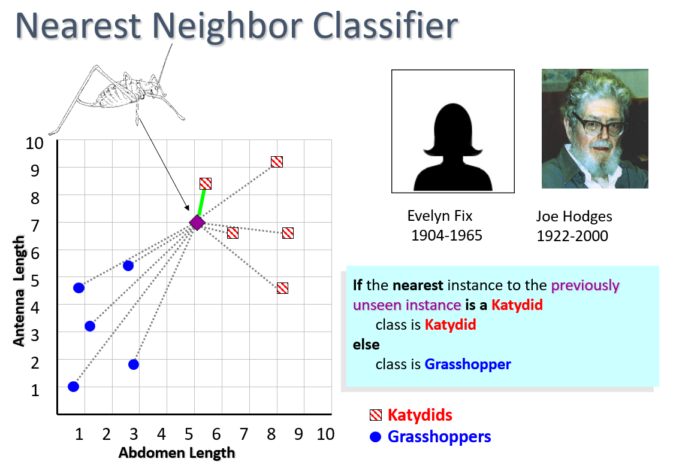

Slide 26
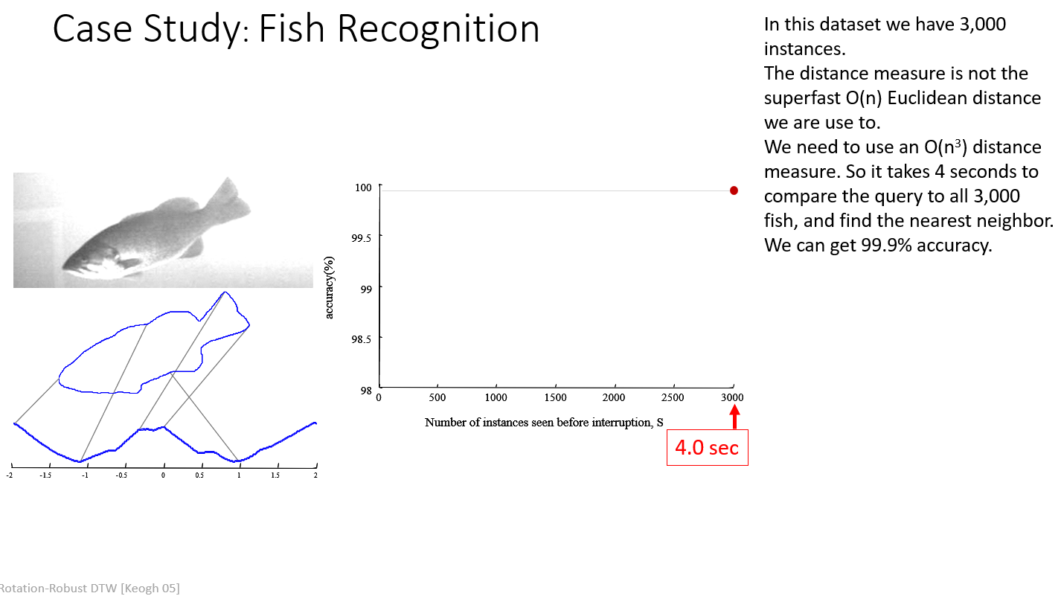

Slide 27
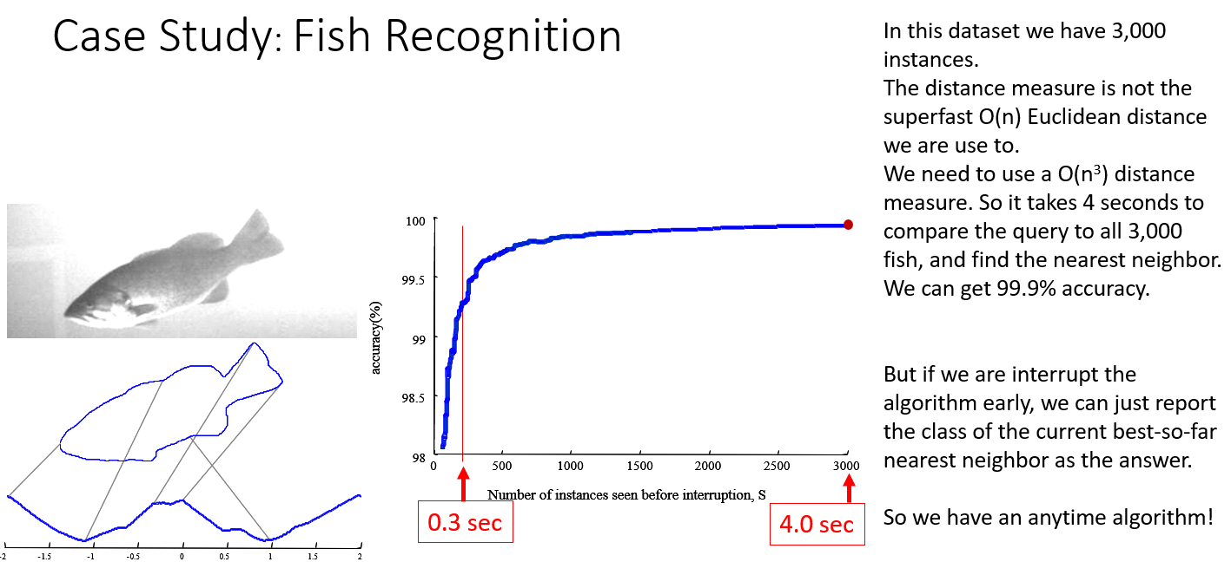

Slide 28
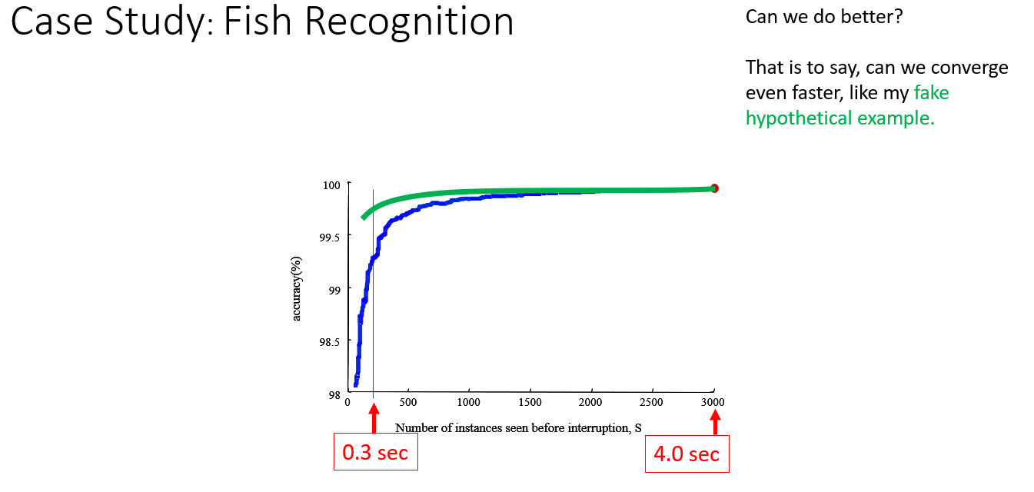

Slide 29
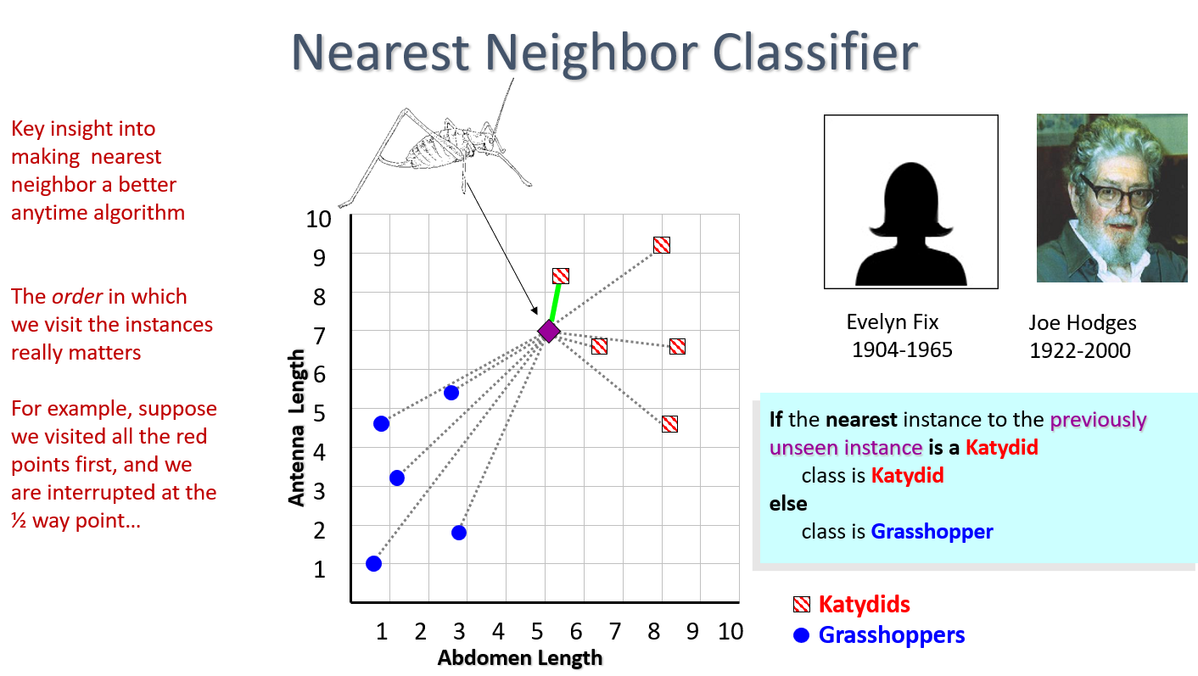

Slide 30
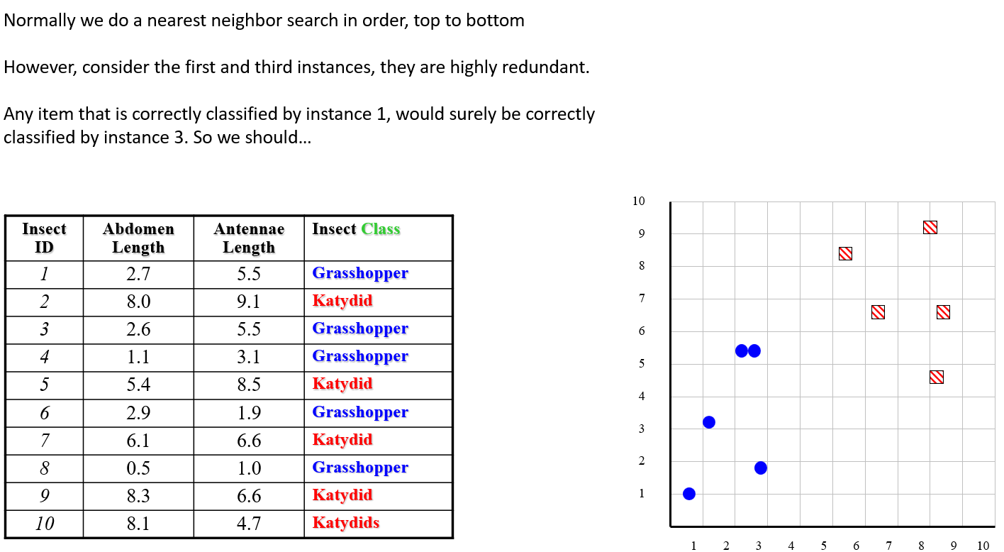

Slide 31
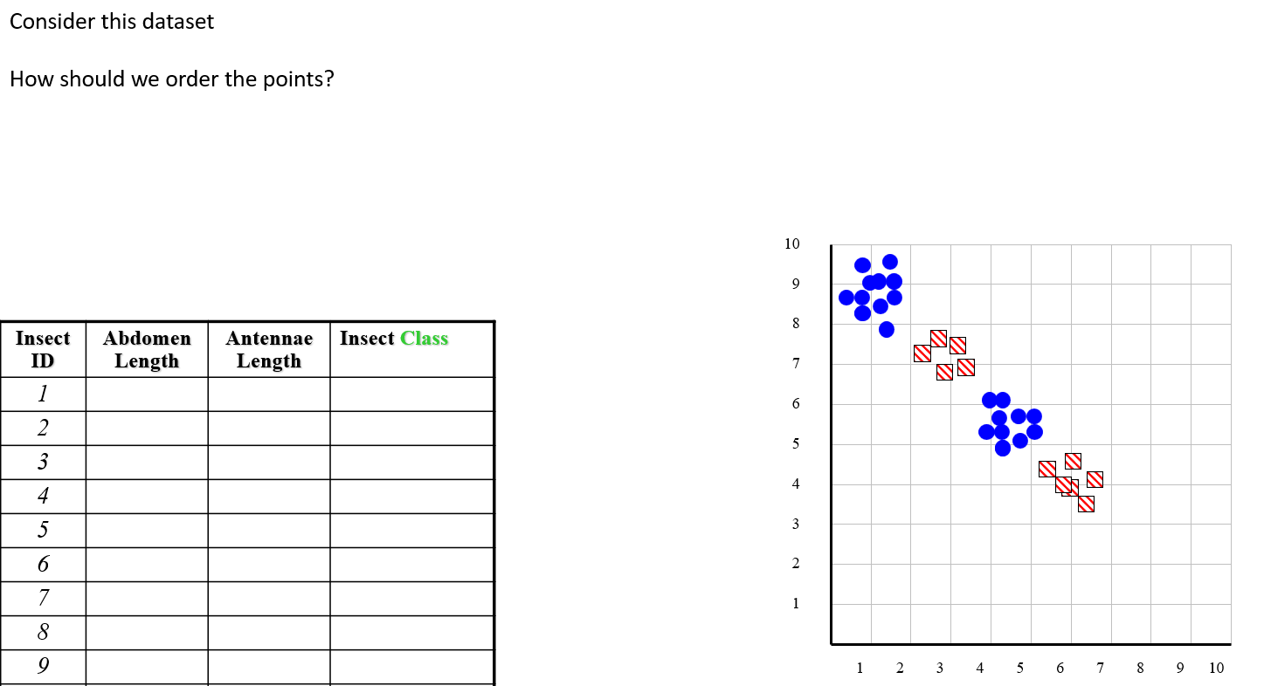

Slide 32
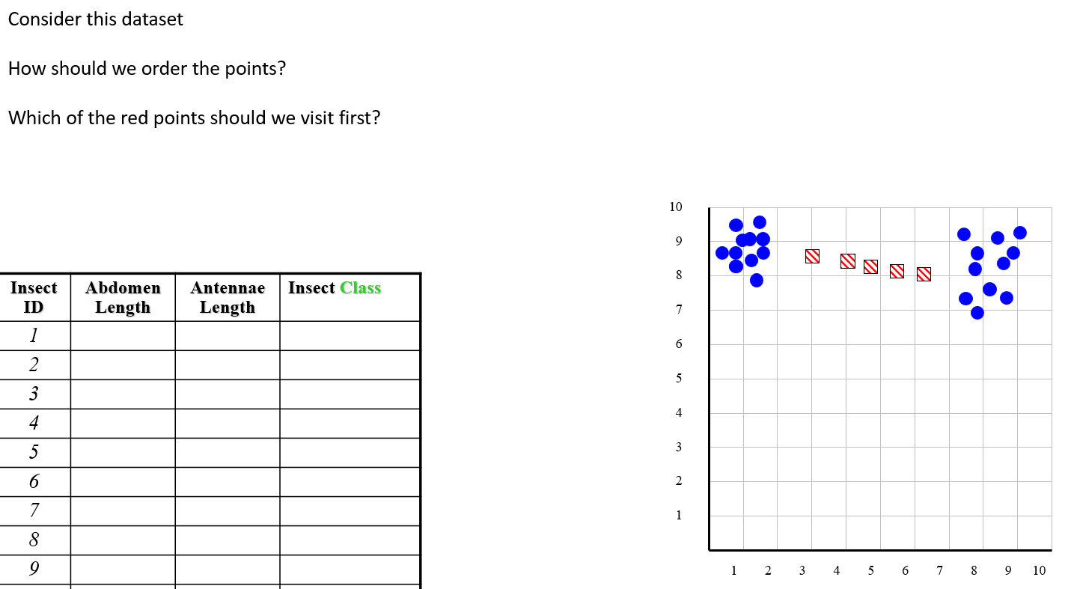

Slide 33
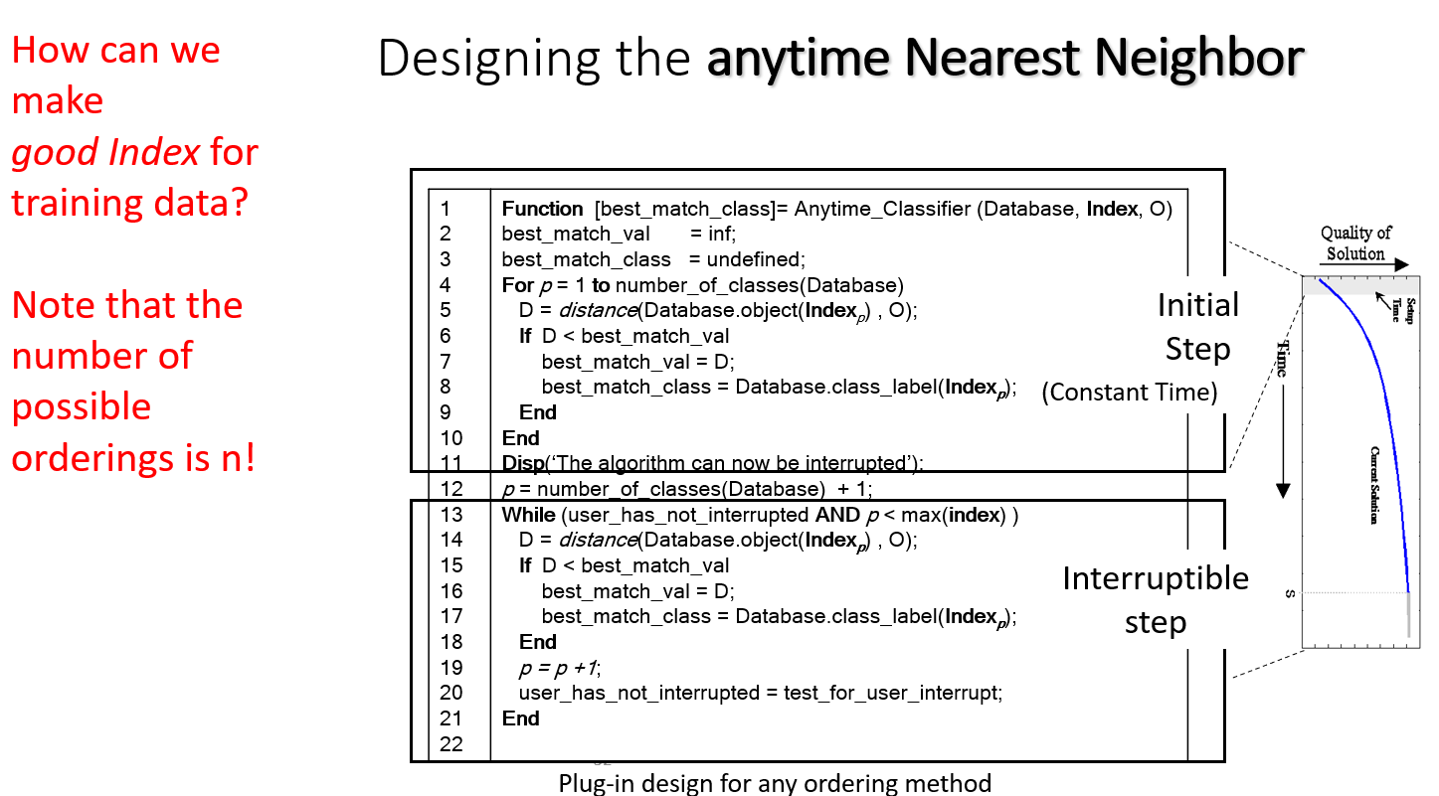

Slide 34
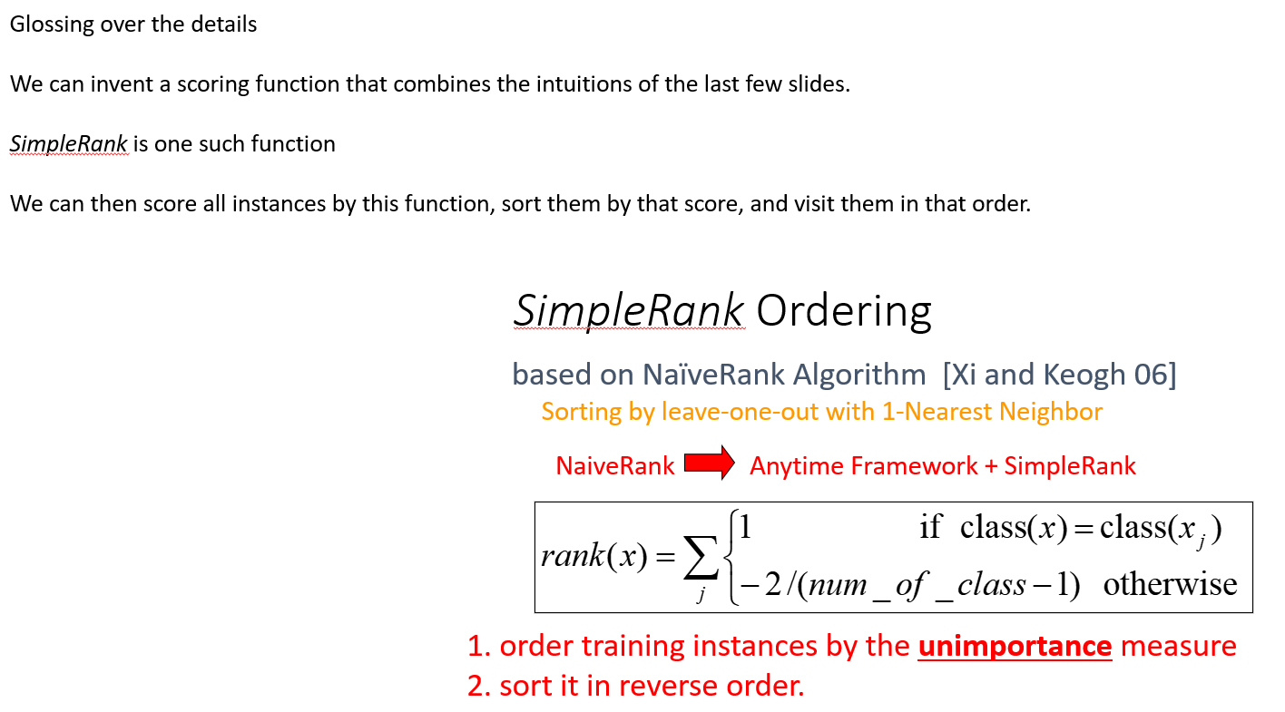

Slide 35
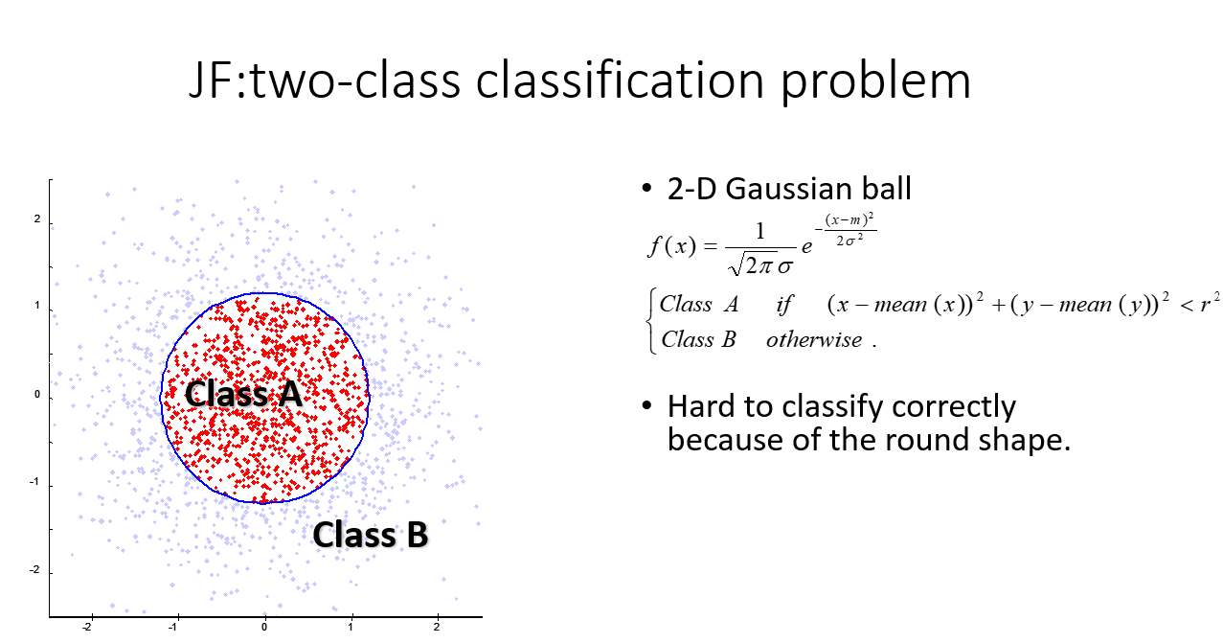

Slide 36
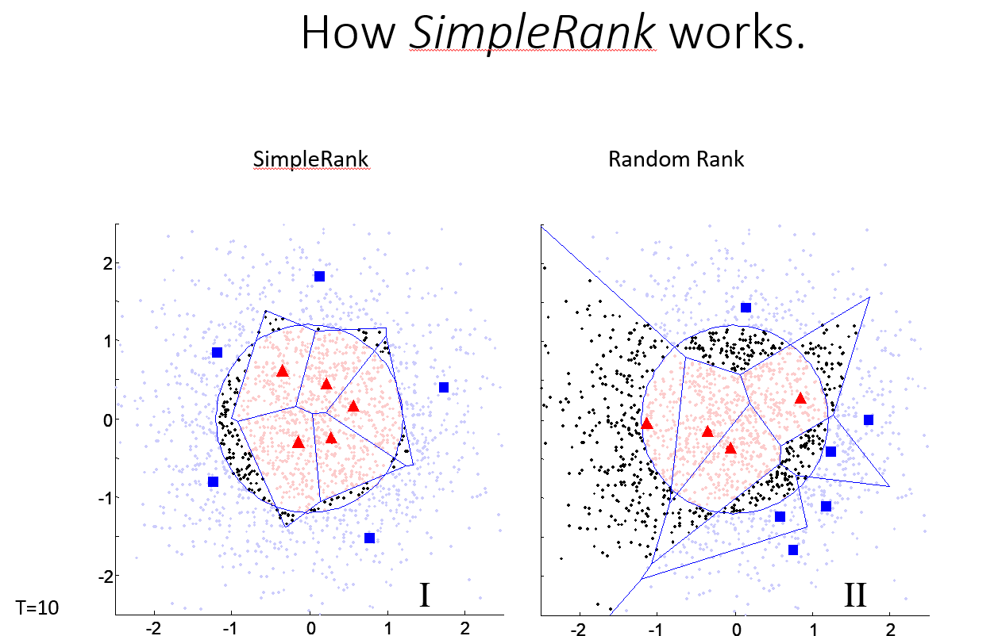

Slide 37
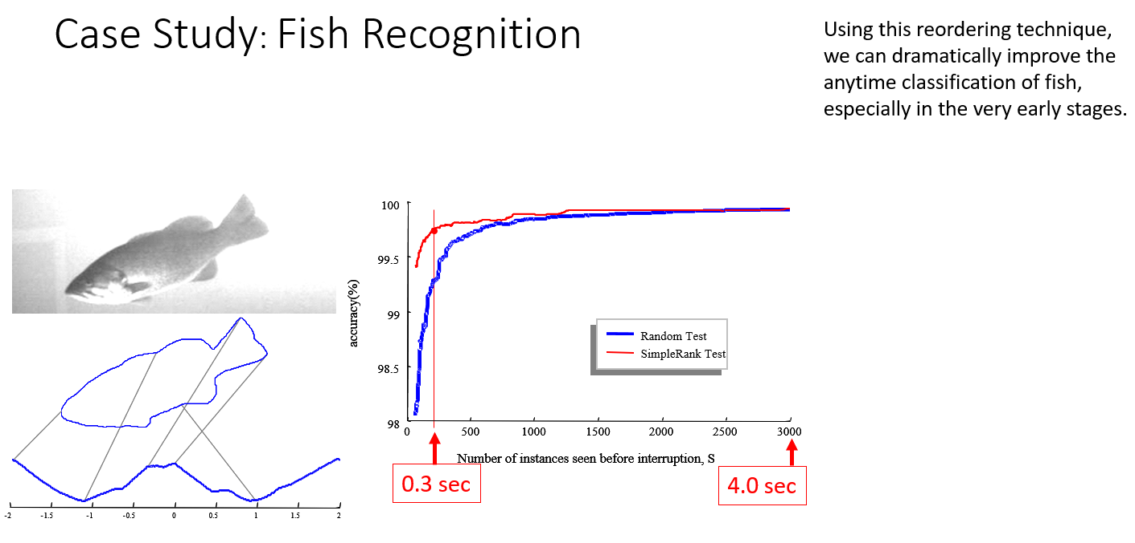

Slide 38
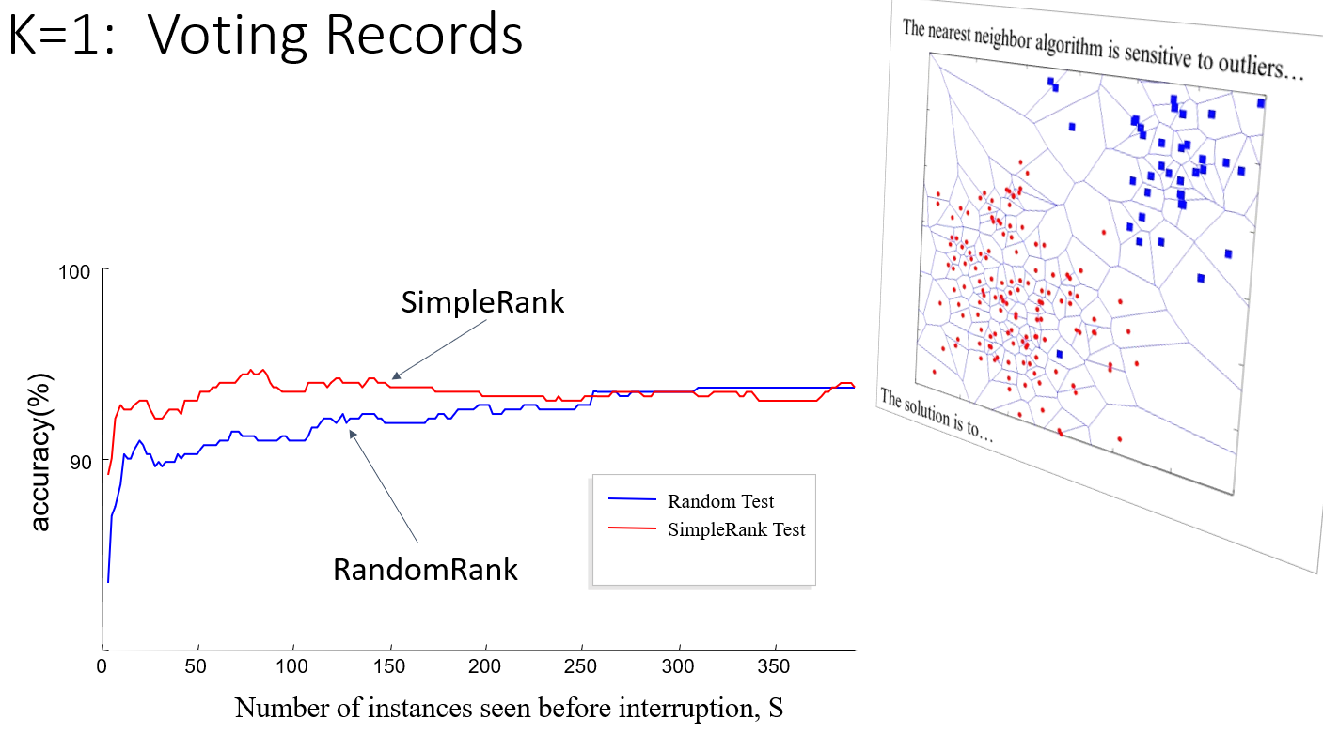

Slide 39
K=1: Forest Cover Type

Slide 40
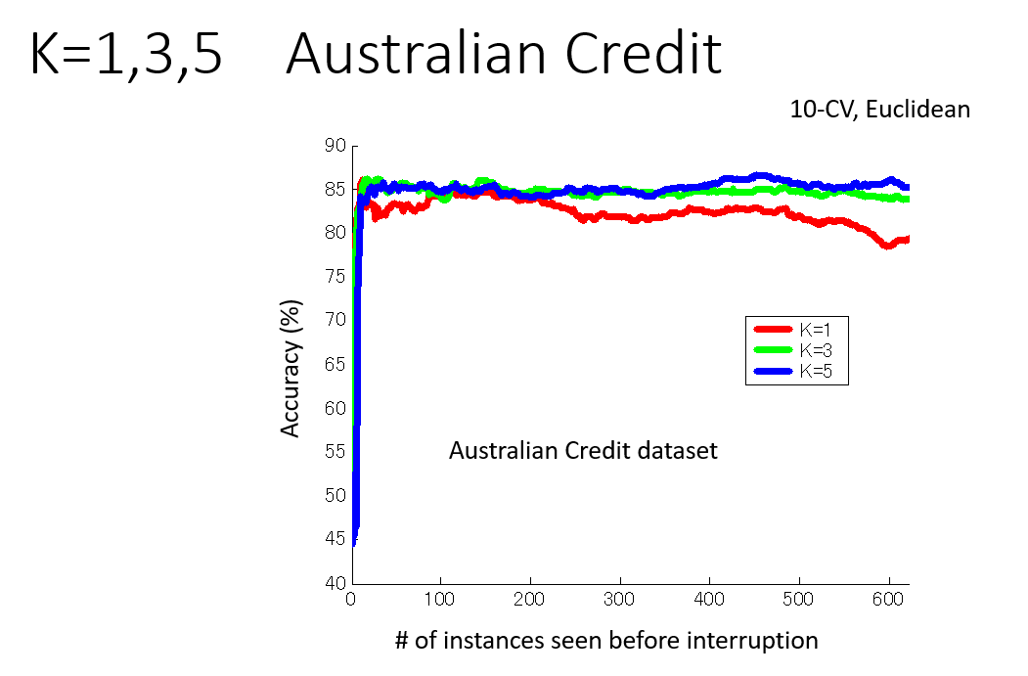

Slide 41
Conclusion
Normal batch algorithms are often too brittle to be deploy for real-world applications
Where possible, we should try to use anytime algorithms.
(as an aside, converting a batch algorithm, to an anytime algorithm can be a nice research project)

